Slide 1
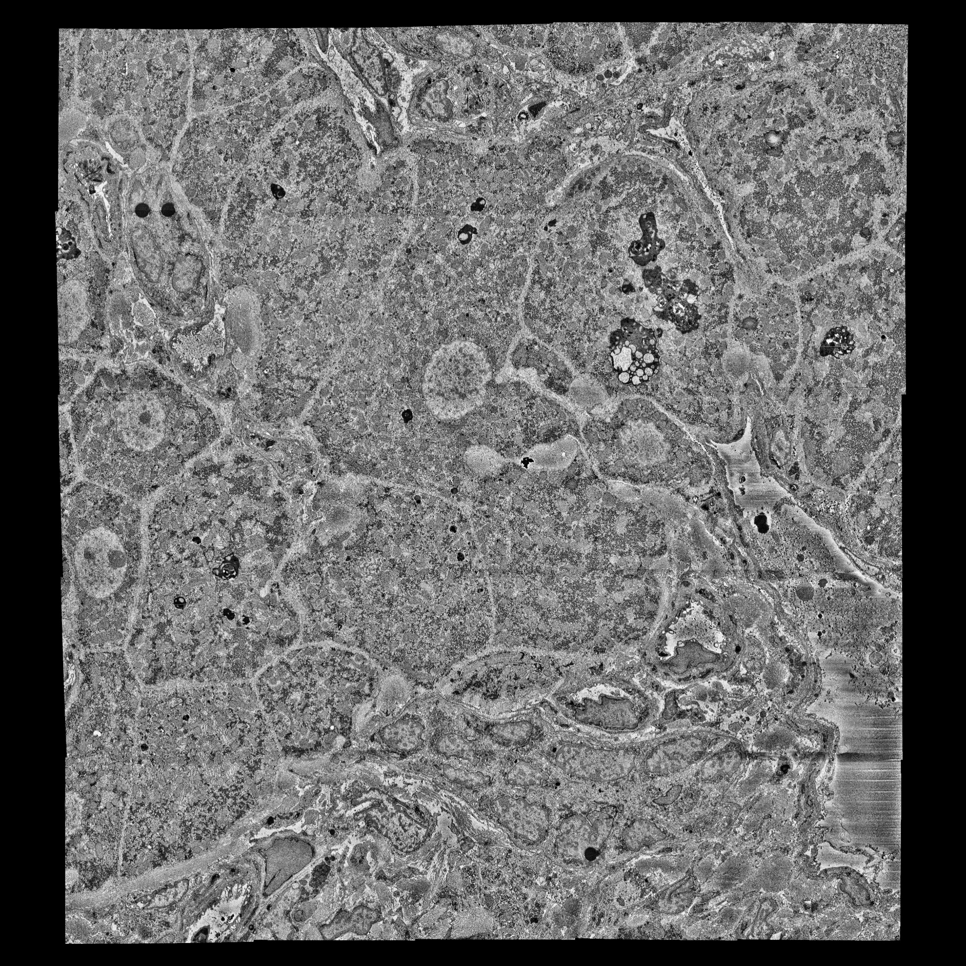
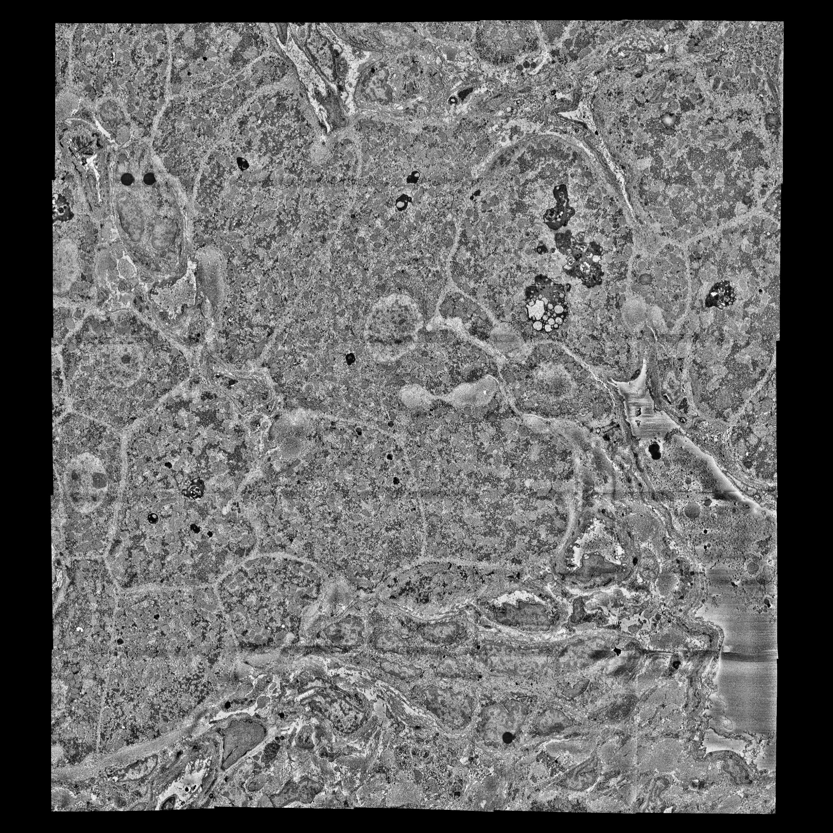
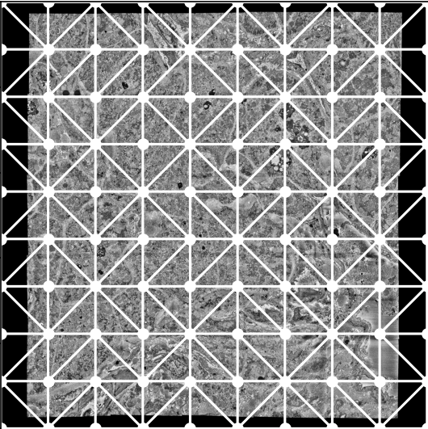
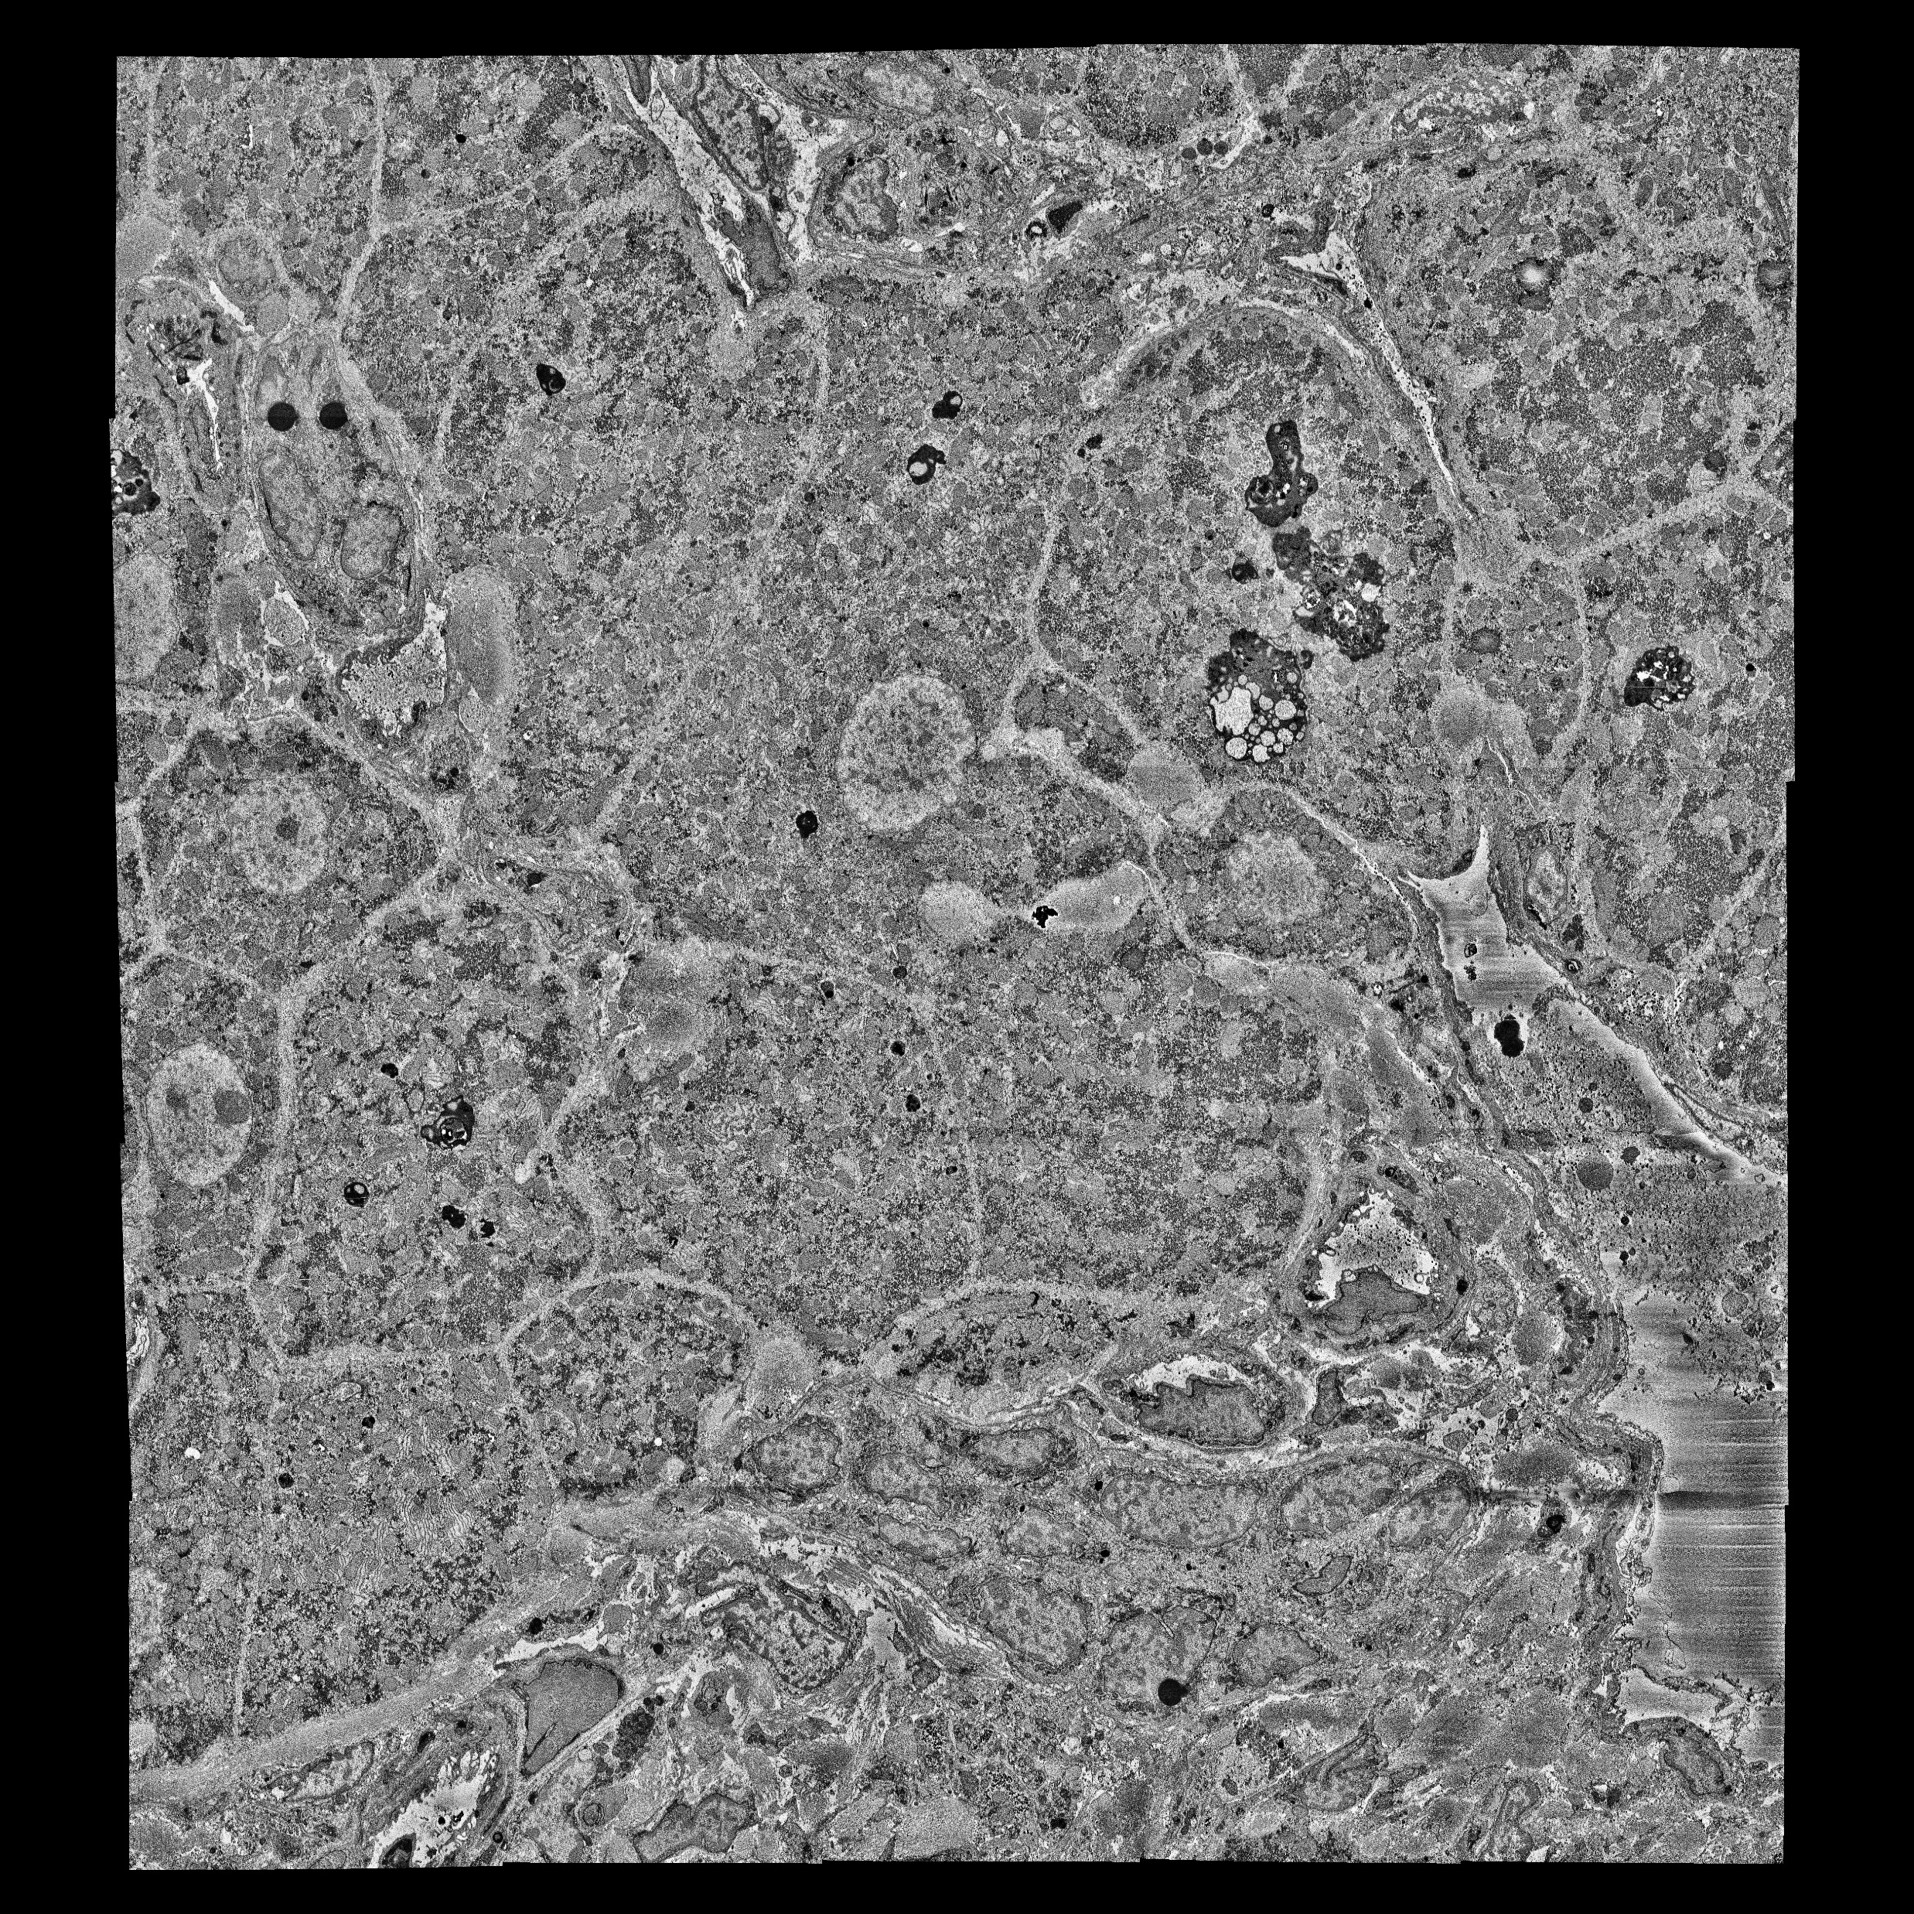


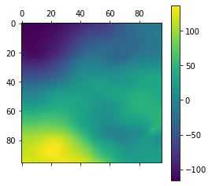
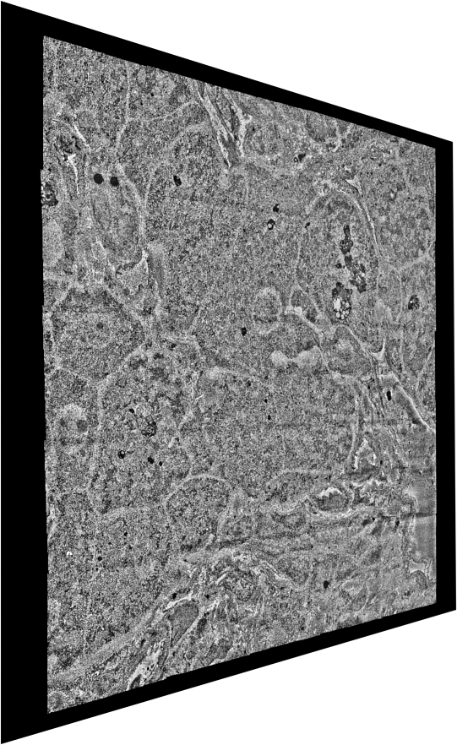
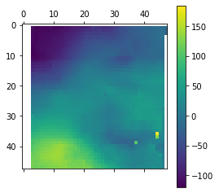
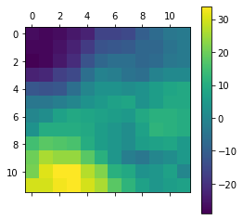
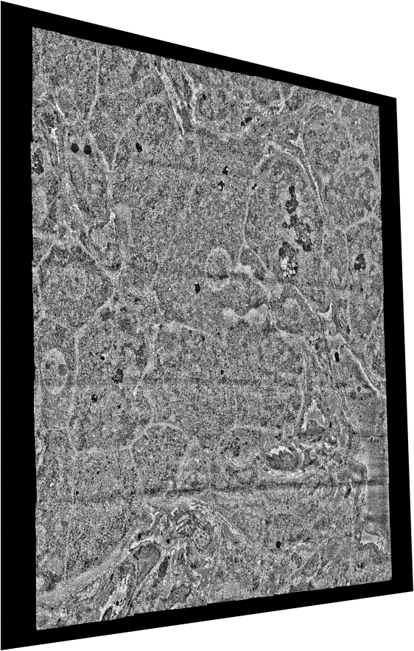
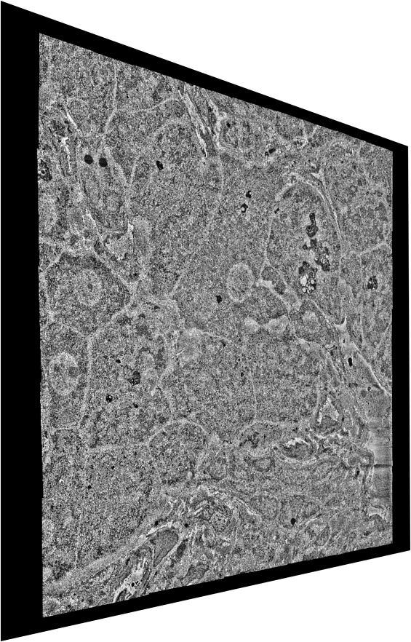
SAToRI: Stitching and Alignment Tools for High-Resolution Images
Global Alignment
Rough Alignment
Rough Optimization
(Image modelled as a spring-mesh system with connections to neighbouring z-layers)
(Affine motion between images)
(Matching points in downsampled images)
Rendering
Fine Optimization
Fine Alignment
(Full-resolution image stacks)
(Relaxed flow fields)
(Fine flow fields between images)

